Slide 1
SUSPICIOUS ACTIVITY DETECTION USING OpenCV
Team -11 Team Members:
1. Bhawna Priya
2.Bhavana V
3.Deeksha Udasi
4.Kavita Hegde
5.Reshma S B

Slide 2
ABSTRACT:
The analytic video is a very challenging area of research in computer vision.
Ensuring a high level of security in a public space monitored by a surveillance camera is a difficult task in recent years.
Understanding peoples’ behaviors in real time allows the surveillance systems to analyze unusual events through the video frames.
In this project, we propose a new approach for detecting suspicious behavior of moving people.

Slide 3
Project Solution:
The project serves to reduce the crime rate. It aims to increase the efficiency of security guards performing surveillance.
The project alerts the user of suspicious activity in multiple parking lots.
The project itself is scalable enough to incorporate other functionality with relative ease.
It logs the suspicious activity for future reference.
It operates in real-time and has an effective accuracy of greater than 90% for detecting positive suspicious activity when setting up in a specific parking lot.
The final decision to decide whether an offense has been committed is still up to the user.

Slide 4
Introduction
Imagine a system that takes video from surveillance cameras, understands when something abnormal occurs and relays this information to the relevant user.
This would free up the human resources that are now being used to monitor video from these cameras, enable cameras that are not being used actively to join in without extra cost and gain much more than a post incident forensic tool.
In this project the current solutions available for abnormality detection will be reviewed, state of the art papers will be studied and a method for abnormality detection will be designed, implemented and tested.

Slide 5
Dataset
In this paper, the dataset we used is derived from https://www.kaggle.com/mateohervas/dcsass-dataset.
Suspicious activity dataset contains videos based on the following 2 classes: Robbery and Vandalism.
There is a total of 394 videos of each class.
We are extracting the image frames from these videos at regular intervals to create a dataset consisting of enough images to train our model.

Slide 6
Technologies Used:
Jupyter Notebook Environment / Google Colab
Machine learning algorithms (CNN)
Python ( numpy, matplotlib, ImageDataGenerator, Keras, SMTP)
OpenCV
Twilio

Slide 7
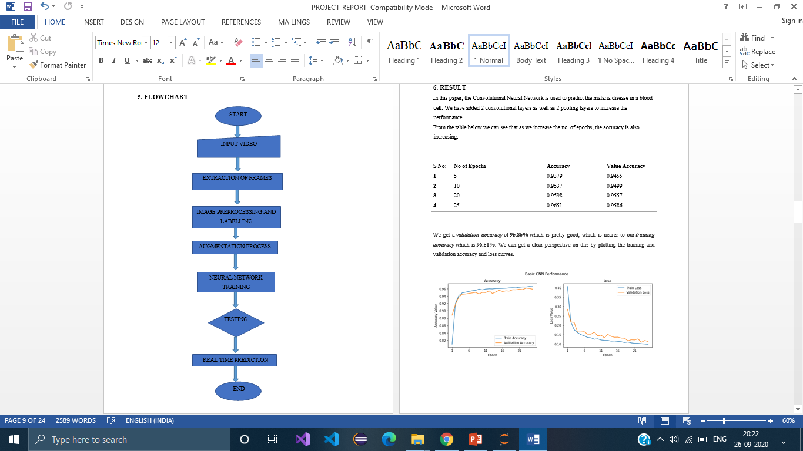
Flowchart

Slide 8
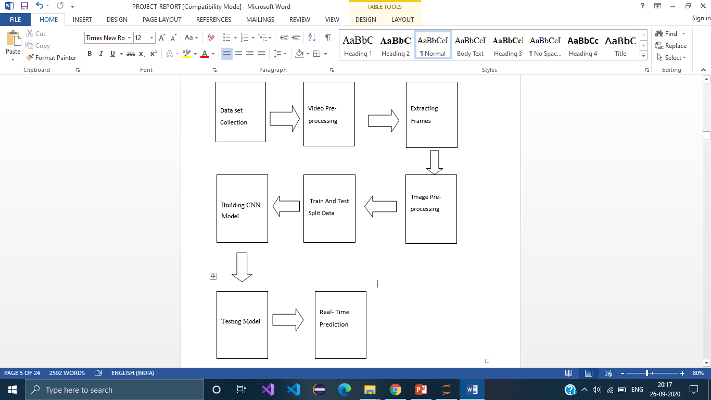
Block Diagram

Slide 9
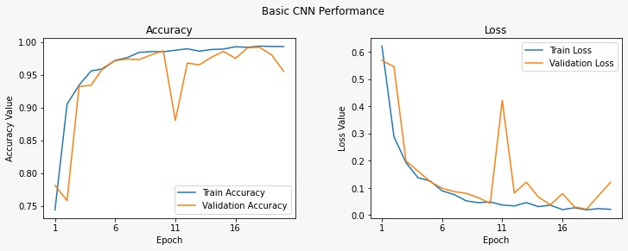
Result
In this project, Convolutional Neural Network is used to predict the Suspicious activity, Normal, Robbery and Vandalism videos. We have added 3 convolutional layers as well as 3 pooling layers to increase the performance.
From the graph below we can see that as we increase the no. of epochs, the accuracy and loss. We got 99.3% accuracy for our model.

Slide 10
ADVANTAGES AND DISADVANTAGES :
Advantages:
It can easily identify the Robbery and Vandalism happening.
It can detect suspicious activities from images of respective catagories.
It is composed using the Python, CNN and message API for it’s usage in real time.
It works in real time and predict as soon as something suspicious happens in front of the camera and predict the result.
Disadvantages:
Our model can detect only few types of suspicious activities.
The calculation becomes incompatible because the images of the given activities are not perfect.
It requires huge dataset for training.
It has high computational costs. Requires lot of time during training of the model.

Slide 11
APPLICATIONS
Deep learning based model can detect suspicious activity from given images with accuracy of 99% while requiring just few floating point operations .
Suspicious Activity Detection using Opencv, which can detect suspicious activities like vandalism and robbery only from providing similar images as dataset can help us a lot in real life.
For practical validation of model efficiency, we have deployed the real-time model for Image processing operations and video analysis for object detection for a better output.
So we use Machine Learning Algorithms using Python to analyze the data and propose suspicious activity detection. We can extend this model to detect few more types of suspicious activites.

Slide 12
CONCLUSION
The initial problem of classifying 2 suspicion categories was a challenging multi-class classification problem, and there was not enough predictability in our initial data-set to obtain very high accuracy on it.
We found that a more meaningful approach was to collapse the categories into fewer, larger groups, in order to find structure in the data. We got high accuracy and precision on the Prediction.
If proper dataset is available, we can extend this model to predict few more or all kind of suspicious activities which happen in real world.

Slide 13
THANK YOU

